Slide 1
CSS
Parker Zhou
parkerzho2010@gmail.com

Slide 2
Topic
History
Understanding the css specification
Basic
Format
Selector
Priority
Inheritance
Color
Font
Table & list
Box model
Inline & block
Float
Position
Advance
Media query
Responsive design
Transform
Transition
Animation

Slide 3
History
1996
1998
2004
CSS1.0
CSS2.0
CSS2.1
Notes:
1996

Slide 4
Understanding the css specification
Features are breaking into group, called module
Modules has its own Level, most of them are working on the level 3, so that is we called CSS3
W3C publishes snapshot periodically
Notes:
a few secondary features hold back the whole specification ,In order to accelerate the standardization of non-problematic features. divided CSS in smaller components called modules, Each of these modules is now an independent part of the language and moves towards standardization at its own pace
http://www.w3.org/Style/CSS/current-work

Slide 5
W3C Policy
4 Different State
Working Draft
Candidate Recommendation
Proposed Recommendation
Recommendation
Notes:
A Working Draft is a document that W3C has published for review by the community, including W3C Members, the public, and other technical organizations. Some, but not all, Working Drafts are meant to advance to Recommendation
A Candidate Recommendation is a document that W3C believes has been widely reviewed and satisfies the Working Group's technical requirements. W3C publishes a Candidate Recommendation to gather implementation experience.
after wide review for technical soundness and implementability, W3C has sent to the W3C Advisory Committee for final endorsement.
Formal release of the publication，W3C recommends the wide deployment of its Recommendations

Slide 6
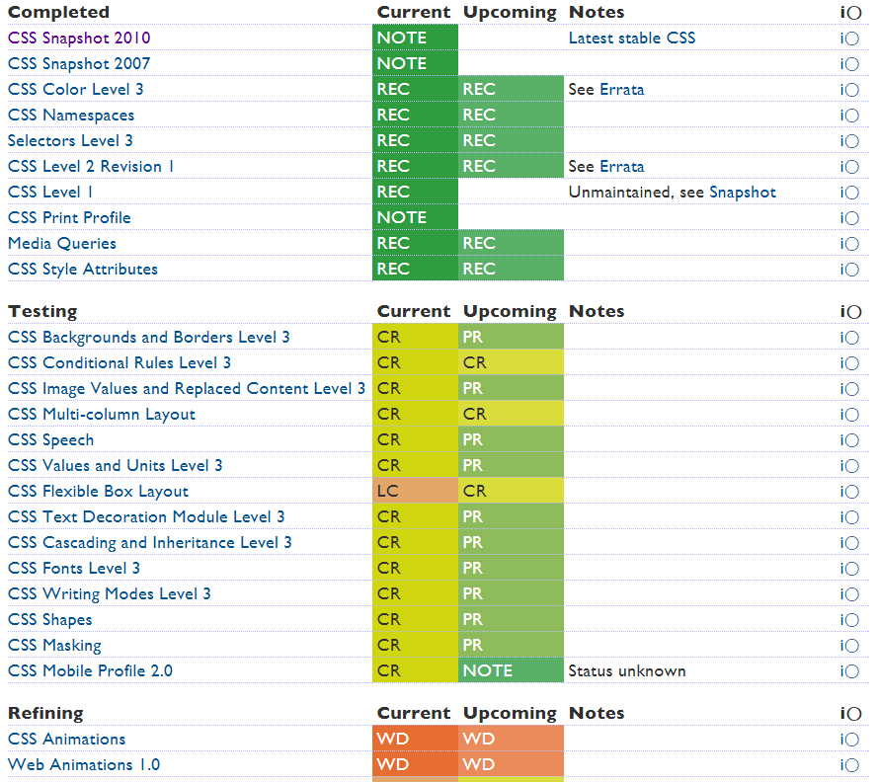
Notes:
Working draft doesn’t mean you are not able to use, and REC doesn’t mean you can use it in any browser!

Slide 7
Basic - format
property : value
Prefix
-moz-box-sizing
-webkit-box-sizing
-o-box-sizing
-ms-box-sizing
<p style="color:yellow">Hello, Html5!</p>
Notes:
example

Slide 8
Basic - format
inline style
embedded style
external style
priority
Notes:
Example
Media=screen print

Slide 9
Basic - Selector
Selector { property: value; … }
To locate elements in the document, and assign a set of property-value pairs to the elements
Case-insensitive
Notes:
http://www.w3.org/TR/selectors/

Slide 10
Basic - Selector
Selector | Name | Description
* | Universal Selector | All elements
E | Type Selector | By tag
#id | ID Selector | By attribute ID
.class | Class Selector | By attribute class
E F | Descendant Selector | Select F element which is descendant of an E element
E,F | Grouping | Select both E and F
Notes:
example

Slide 11
Basic - Selector
Selector | Name | Description
E[foo] | Attribute Selector | an E element with a "foo" attribute
E[foo="bar"] | Attribute Selector | "foo" attribute value is exactly equal to "bar"
E[foo~="bar"] | Attribute Selector | "foo" attribute value is a list of whitespace-separated values, one of which is exactly equal to "bar"
E[foo^="bar"] | Attribute Selector | Begin with
E[foo$="bar"] | Attribute Selector | End with
E[foo*="bar"] | Attribute Selector | substring
E[foo|="en"] | Attribute Selector | has a hyphen-separated list of values beginning (from the left) with "en"
Notes:
example

Slide 12
Basic - Selector
“pseudo”
Selector | Name | Description
E:first-child | pseudo-classes | an E element and is first child of its parent
E:nth-child(n) | pseudo-classes | an E element and is n-th child of its parent
E:first-of-type | pseudo-classes | an E element, first sibling of its type
E:empty | pseudo-classes | an E element without children
E:hover | pseudo-classes | E element when user mouse hover it
E::before | pseudo-element | generated content before an E element
E::after | pseudo-element | generated content after an E element
Notes:
: usually means its self
:: select something of it or something in it

Slide 13
Basic – Priority
!Important declaration
color:#999!important
Specificity
if browser can determine which rule is most specific, there is no need to examine the textual order
Textual Order
browser determines the textual order of the style rules where the last style rule in textual order has precedence over prior style rules

Slide 14
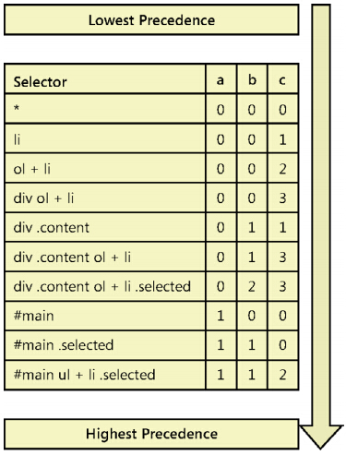
Basic – Priority
Specificity
p162
Notes:
a Record the number of id attributes in the selector.
b Record the quantity of class selectors, attributes selectors, and pseudo classes.
c Record the quantity of element names in the selector

Slide 15


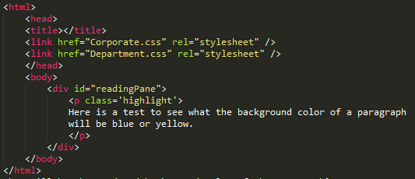
Basic – Priority
Lesson Review
Corporate.css
Department.css
What will be the rendered background color of the paragraph?

Slide 16

Basic – Priority
Lesson Review
Corporate.css
Department.css
What will be the rendered background color of the paragraph?

Slide 17
Basic – inheritance
An element can get its style from a parent element when no other styles are defined
Any Specificity can override

Slide 18
Basic – color
Color literal
RGB/RGBA
HSL/HSLA
6/3 characters Hexadecimal value leading with ‘#’
Color | RGB | Hex
black | rgb(0,0,0) | #000000(#000)
white | rgb(255,255,255) | #ffffff(#fff)
red | rgb(255,0,0) | #ff0000(#f00)
green | rgb(0,255,0) | #00ff00(#0f0)
blue | rgb(0,0,255) | #0000ff(#00f)
gray | rgb(204,204,204) | #cccccc(#ccc)

Slide 19


Basic – color
rgba(red, green, blue, alpha)
Alpha is from 0.0(totally transparent) to 1.0(none transparent)
Opacity
rgba(255,0,0,0.2)
rgba(255,0,0,1)
Notes:
zoom: 1;
filter: alpha(opacity=50);

Slide 20
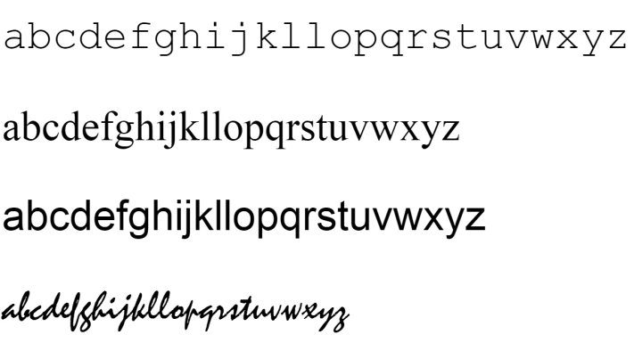
Basic – font
font-family
Font | Description
monospace | Font families in which all characters have the same width, such as Courier New
serif | Font families with serifs or curls at the top and bottom of characters, such as Times New Roman
sans serif | Font families without serifs, such as Arial
cursive | Font families that imitate handwriting, such as Mistral
fantasy | Font families that are decorative
p:first-child {
font-family: "Courier New",monospace;
}
Notes:
Finish-stroke

Slide 21
Basic – font
font-size
Units | Description
in | An absolute measurement inch unit, 1in = 2.54cm
px | An absolute measurement pixel unit, 96 pixels per inch
em | A relative measurement multiplier of the parent element’s computed font size, usually 1em = 16px
pt | An absolute measurement point unit, 72 points per inch
cm | An absolute measurement centimeter unit
p {
font-size: 2.5em;
}

Slide 22
Basic – font
font-style : normal | italic | oblique | inherit
font-variant : normal | small-caps | inherit
font-weight : normal | bold | bolder | lighter | 100-900| inherit
100
200
300
400 normal
500
600
700 bold
800
900

Slide 23
Basic – font
All in one
font : font-style font-variant font-weight font-size/line-height font-family
p.ex1 {
font : italic arial,sans-serif;
}
p.ex2 {
font : italic bold 12px/20px arial,sans-serif;
}
Notes:
font-style font-variant font-weight font-size/line-height font-family

Slide 24
Basic – font
@font-face
@font-face {
font-family: 'FontAwesome';
src: url('../fonts/fontawesome-webfont.eot?v=3.2.1');
src: url('../fonts/fontawesome-webfont.eot?#iefix&v=3.2.1') format('embedded-opentype'),
url('../fonts/fontawesome-webfont.woff?v=3.2.1') format('woff'),
url('../fonts/fontawesome-webfont.ttf?v=3.2.1') format('truetype'),
url('../fonts/fontawesome-webfont.svg#fontawesomeregular?v=3.2.1') format('svg');
}
.icon {
font-family: FontAwesome;
}

Slide 25


Basic - Table & list
default table style
table,td,th{
border: 1px solid #ccc;
}
table,td,th{
border: 1px solid #ccc;
border-collapse: collapse;
}
Notes:
You can not control the column’s width

Slide 26




Basic - Table & list
Default ul,ol
ul {
list-style: none;
}
ul {
list-style: square;
}
ul {
list-style: none;
padding: 0;
margin: 0;
}

Slide 27
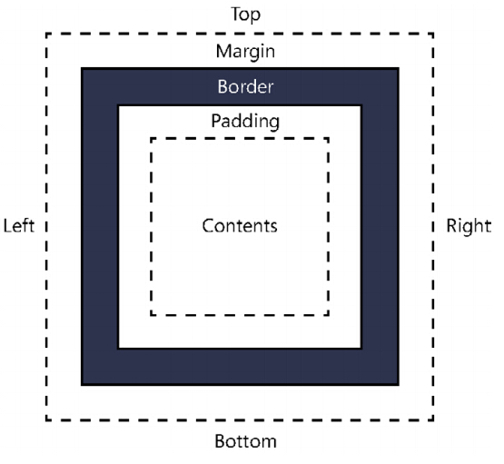
Basic – Box model
Notes:
example

Slide 28
Basic – Box model
box-sizing: decide how to calculate the width and height of box element
box-sizing : content-box | border-box | padding-box
content-box : only content
border-box : include padding width and border width
padding-box : include padding width(only firefox)
Notes:
example

Slide 29
Basic - Inline & block
Inline element : elements will be rendered in a single line one by one
<span> <a> <em>…
Block element : element always be rendered and took up a whole line, everything next will begin in a new line
<div> <p>
Block element are follow the box model and can be set using width and height

Slide 30
Basic – Float
Normal render flow : means browser renders element from top to bottom(for block) and from left to right(for inline)
Element with `float` will be pull out from the normal render flow and put into another flow which is over the normal one

Slide 31
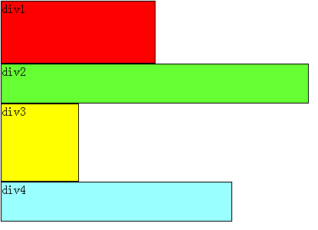
Basic – Float
No float

Slide 32
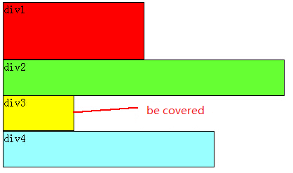
Basic – Float
#div2 {
float:left;
}

Slide 33
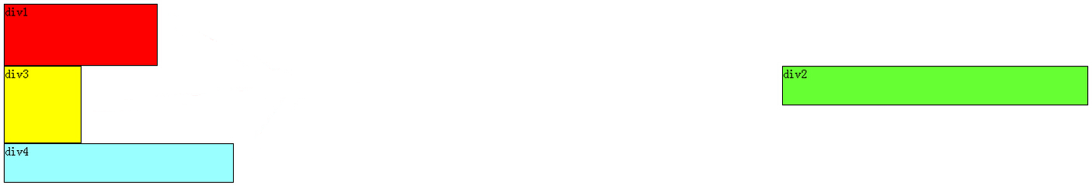
Basic – Float
#div2 {
float:right;
}
Float-left means the floated one will dock to left
Float-right means the floated one will dock to right

Slide 34
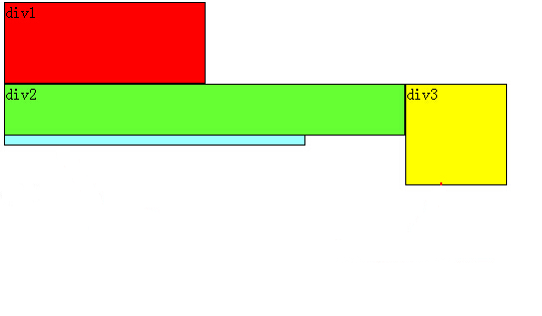
Basic – Float
#div2 {
float:left;
}
#div3 {
float:left;
}
#div3 is closely following #div2 in the non-normal flow

Slide 35
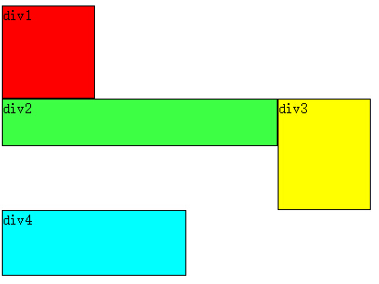
Basic – Float
#div2 {
float:left;
}
#div3 {
float:left;
}
#div4 {
clear:both;
}
Usually we don’t want leave #div4 be covered. We have to use `clear` to clear the float

Slide 36
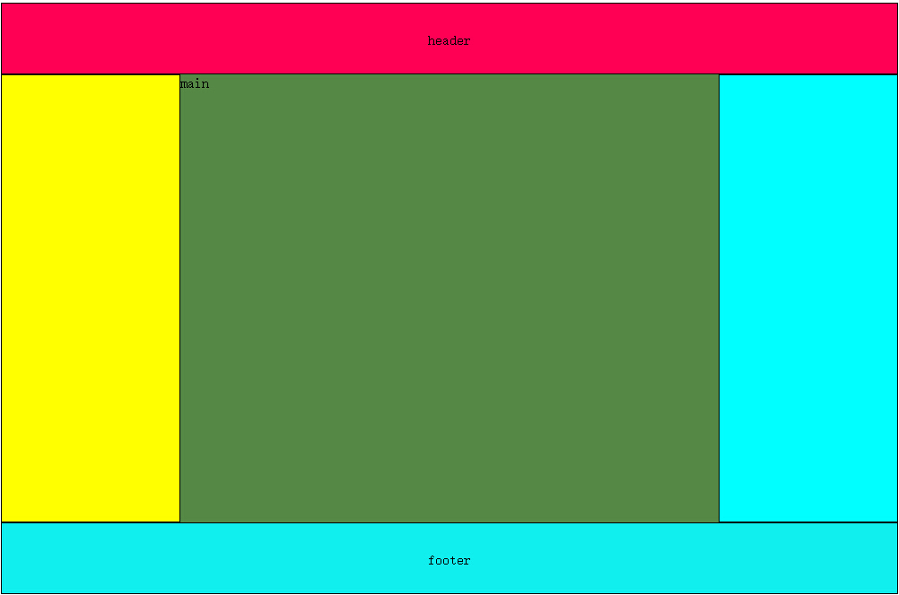
Basic – Float
Float is used to layout block element inline rather than the default behavior
Notes:
Have a try
Layout with fixed width
Add a border,and see the box-sizing problem

Slide 37

Basic – Float
TRICK1
<div style="clear:both;“></div>
TRICK2
.clearfix:after {
content: " ";
display:block;
clear: both;
visibility: hidden;
height: 0px;
}

Slide 38
Basic – Position
Fixed : the box is fixed with respect to the viewport and does not move when scrolled

Slide 39
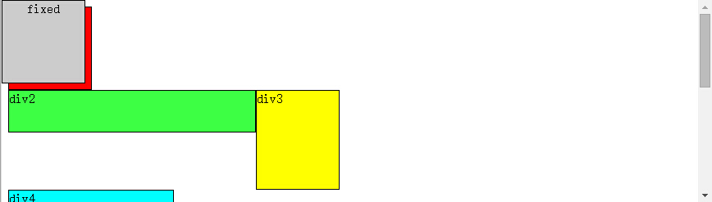
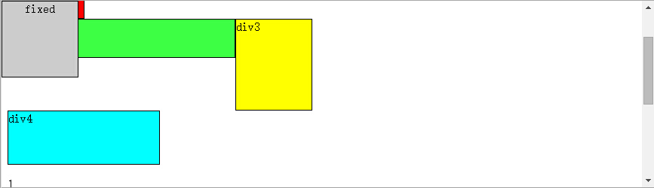
Basic – Position
.fixed {
position: fixed;
top: 0px;
left: 0px;
width: 100px;
height: 100px;
background: #ccc;
text-align: center;
}

Slide 40
Basic – Position
Relative : the box is offset relative to its normal position. When a box B is relatively positioned, the position of the following box is calculated as though B were not offset.

Slide 41
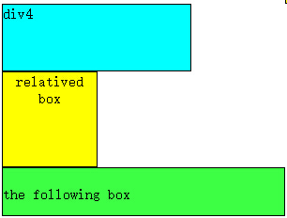
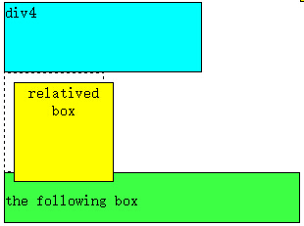
Basic – Position
<div id="div4">div4</div>
<div class ="relative">relative</div>
<div id="div2"><br/>the following box</div>
.relative {
}
.relative {
postion:relative;
top:10px;
left:10px;
}

Slide 42
Basic – Position
Absolute : position is specified with the 'top', 'right', 'bottom', and 'left' properties, These properties specify offsets with respect to the box's viewport or positioned containing block

Slide 43
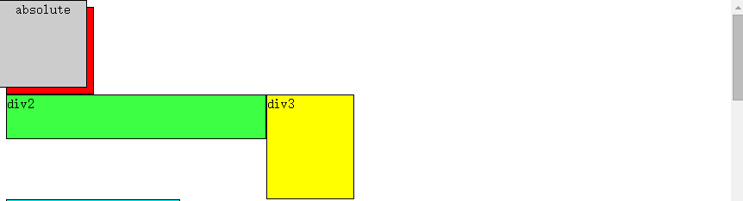
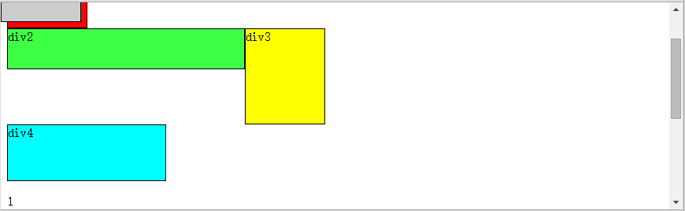
Basic – Position
.absolute {
position: absolute;
top: 0px;
left: 0px;
width: 100px;
height: 100px;
background: #ccc;
text-align: center;
}

Slide 44
Basic – Position
<div id="div2“>
<div id="div3“></div>
</div>
#div2 {
position: relative;
…
}
#div3 {
position: absolute;
top: 10px;
right: 10px;
…
}
Notes:
<div id=

Slide 45
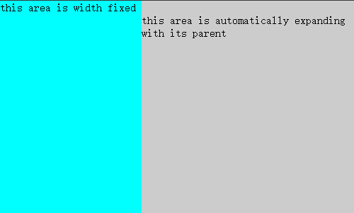
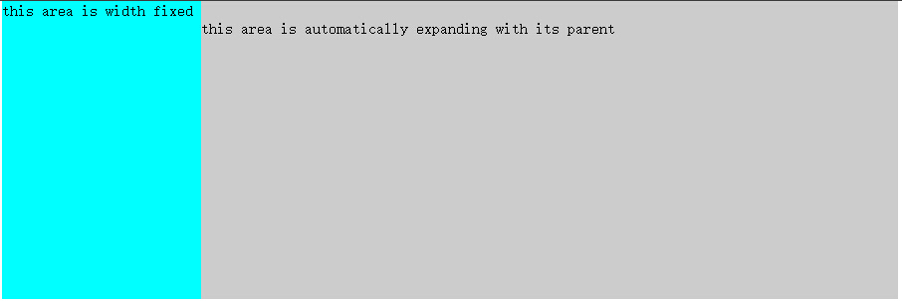
Basic – Exercise
*{margin:0;padding:0}
.container{
width:500px;
position:relative;
height:300px;
}
.slider{
width:200px;
height:100%;
background-color:#0ff;
}
.content{
position:absolute;
top:0;
left:200px;
right:;
height:100%;
background-color:#ccc;
}
<div class="container">
<div class="slider">
this area is width fixed
</div>
<div class="content">
<p>
<br/>this area is automatically expanding with its parent</p>
<div>
</div>

Slide 46
Basic
Border
Background
Text-style
...

Slide 47




Demo
Try to fix a checkbox style
Notes:
Try to fix a checkbox style

Slide 48
Adv – Media Query
HTML4 and CSS2 currently support media-dependent style sheets for different media types
<link rel="stylesheet" type="text/css" media="screen" href="sans-serif.css">
<link rel="stylesheet" type="text/css" media="print" href="serif.css">
Notes:
For example, a document may use sans-serif fonts when displayed on a screen and serif fonts when printed.

Slide 49
Adv – Media Query
A media query consists of a media type and zero or more expressions that check for the conditions of particular media features.
<link rel="stylesheet" media="screen and (color)" href="example.css" />
This example expresses that a certain style sheet (example.css) applies to devices of a certain media type (‘screen’) with certain feature (it must be a color screen).
Notes:
For example, a document may use sans-serif fonts when displayed on a screen and serif fonts when printed.

Slide 50
Adv – Media Query
@media all and (max-width:500px) {
.topbar-mod{display:none;}
.navigation-mod{display:none;}
…
}
This example expresses that a set of certain styles should be applied to devices of all media type and has maximal width of 500px;
Notes:
For example, a document may use sans-serif fonts when displayed on a screen and serif fonts when printed.

Slide 51
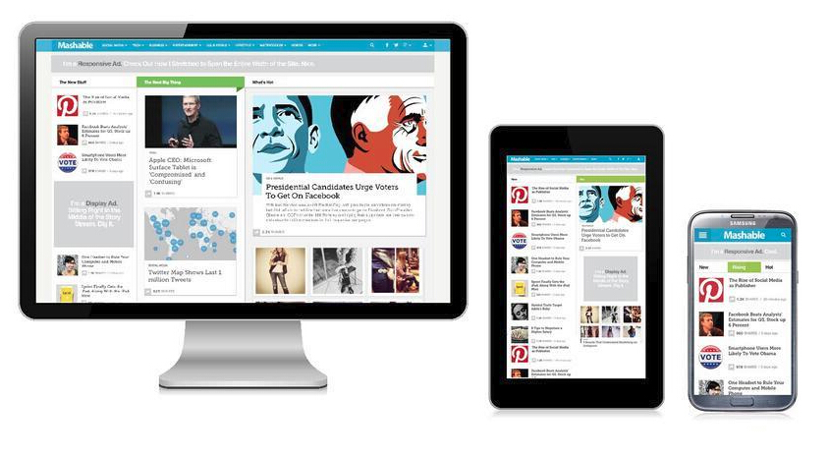
Adv - Responsive design
Typically use media query
Notes:
Responsive web design (RWD) is an approach to web design aimed at crafting sites to provide an optimal viewing experience—easy reading and navigation with a minimum of resizing and scrolling—across a wide range of devices (from desktop computer monitors to mobile phones)
http://nartfest.com/

Slide 52




Adv - Responsive design
Framework for responsive design

Slide 53
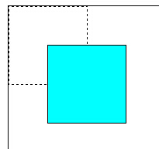
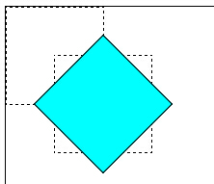
Adv - Transform
#div10{
width: 100px;
height: 100px;
background-color: #0ff;
-webkit-transform: translate(50px,50px);
}
#div10{
width: 100px;
height: 100px;
background-color: #0ff;
transform: translate(50px,50px) rotate(45deg);
}

Slide 54
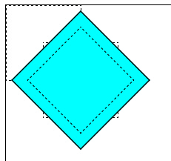
Adv - Transform
#div10{
width: 100px;
height: 100px;
background-color: #0ff;
transform: translate(50px,50px) rotate(45deg) scale(1.3,1.3);
}

Slide 55
Adv - Transistion
Transitions allows property changes in CSS values to occur smoothly over a specified duration
A easy way to apply animation
#div11 {
width: 100px;
-webkit-transition: width 1s;
}
#div11:hover {
width: 200px;
}

Slide 56
Adv - Animation
Create animation with `keyframes`
@-webkit-keyframes color-animation{
0% {background: red;}
25% {background: yellow;}
50% {background: blue;}
100% {background: green;}
}
#div11:hover{
-webkit-animation: color-animation 4s;
}
Notes:
@-webkit-keyframes shake-little{0%{-webkit-transform:translate(0px, 0px) rotate(0deg)}
2%{-webkit-transform:translate(-1px, 0px) rotate(-0.5deg)}
4%{-webkit-transform:translate(-1px, -1px) rotate(-0.5deg)}
6%{-webkit-transform:translate(-1px, -1px) rotate(-0.5deg)}
8%{-webkit-transform:translate(0px, 0px) rotate(-0.5deg)}
10%{-webkit-transform:translate(0px, -1px) rotate(-0.5deg)}
12%{-webkit-transform:translate(-1px, 0px) rotate(-0.5deg)}
14%{-webkit-transform:translate(-1px, -1px) rotate(-0.5deg)}
16%{-webkit-transform:translate(0px, 0px) rotate(-0.5deg)}
18%{-webkit-transform:translate(-1px, -1px) rotate(-0.5deg)}
20%{-webkit-transform:translate(-1px, -1px) rotate(-0.5deg)}
22%{-webkit-transform:translate(0px, -1px) rotate(-0.5deg)}
24%{-webkit-transform:translate(0px, 0px) rotate(-0.5deg)}
26%{-webkit-transform:translate(-1px, -1px) rotate(-0.5deg)}
28%{-webkit-transform:translate(-1px, -1px) rotate(-0.5deg)}
30%{-webkit-transform:translate(-1px, -1px) rotate(-0.5deg)}
32%{-webkit-transform:translate(0px, -1px) rotate(-0.5deg)}
34%{-webkit-transform:translate(-1px, -1px) rotate(-0.5deg)}
36%{-webkit-transform:translate(0px, -1px) rotate(-0.5deg)}
38%{-webkit-transform:translate(-1px, 0px) rotate(-0.5deg)}
40%{-webkit-transform:translate(0px, 0px) rotate(-0.5deg)}
42%{-webkit-transform:translate(-1px, -1px) rotate(-0.5deg)}
44%{-webkit-transform:translate(-1px, 0px) rotate(-0.5deg)}
46%{-webkit-transform:translate(0px, 0px) rotate(-0.5deg)}
48%{-webkit-transform:translate(-1px, -1px) rotate(-0.5deg)}
50%{-webkit-transform:translate(0px, 0px) rotate(-0.5deg)}
52%{-webkit-transform:translate(0px, 0px) rotate(-0.5deg)}
54%{-webkit-transform:translate(0px, 0px) rotate(-0.5deg)}
56%{-webkit-transform:translate(-1px, 0px) rotate(-0.5deg)}
58%{-webkit-transform:translate(0px, -1px) rotate(-0.5deg)}
60%{-webkit-transform:translate(-1px, -1px) rotate(-0.5deg)}
62%{-webkit-transform:translate(-1px, -1px) rotate(-0.5deg)}
64%{-webkit-transform:translate(-1px, 0px) rotate(-0.5deg)}
66%{-webkit-transform:translate(0px, 0px) rotate(-0.5deg)}
68%{-webkit-transform:translate(-1px, 0px) rotate(-0.5deg)}
70%{-webkit-transform:translate(0px, -1px) rotate(-0.5deg)}
72%{-webkit-transform:translate(0px, -1px) rotate(-0.5deg)}
74%{-webkit-transform:translate(-1px, -1px) rotate(-0.5deg)}
76%{-webkit-transform:translate(0px, 0px) rotate(-0.5deg)}
78%{-webkit-transform:translate(0px, -1px) rotate(-0.5deg)}
80%{-webkit-transform:translate(0px, -1px) rotate(-0.5deg)}
82%{-webkit-transform:translate(-1px, 0px) rotate(-0.5deg)}
84%{-webkit-transform:translate(-1px, 0px) rotate(-0.5deg)}
86%{-webkit-transform:translate(0px, 0px) rotate(-0.5deg)}
88%{-webkit-transform:translate(0px, 0px) rotate(-0.5deg)}
90%{-webkit-transform:translate(-1px, -1px) rotate(-0.5deg)}
92%{-webkit-transform:translate(0px, 0px) rotate(-0.5deg)}
94%{-webkit-transform:translate(0px, 0px) rotate(-0.5deg)}
96%{-webkit-transform:translate(-1px, -1px) rotate(-0.5deg)}
98%{-webkit-transform:translate(0px, 0px) rotate(-0.5deg)}
}

Slide 57
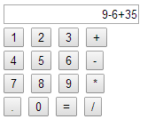
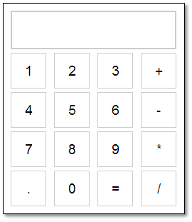
Exercise

